Slide 1

DEPARTMENT OF PHYSICS AND NANOTECHNOLOGY
SRM INSTITUTE OF SCIENCE AND TECHNOLOGY
18PYB103J –Semiconductor Physics
Module-V Lecture-7
Carbon Nano Tubes-Properties, Synthesis and Applications
18PYB103J Module-V Lecture-7

Slide 2
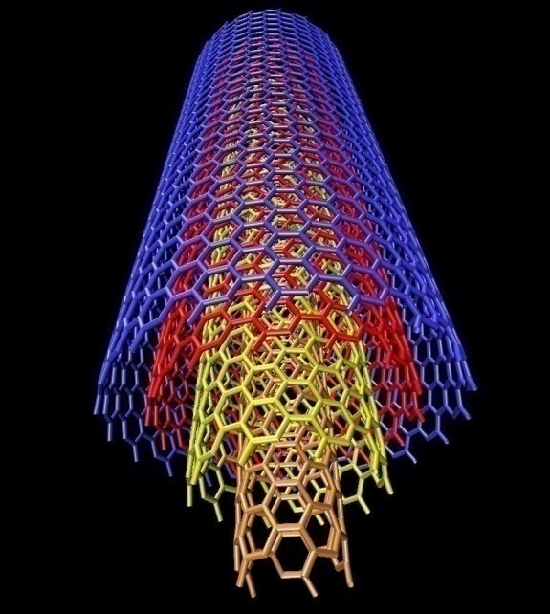
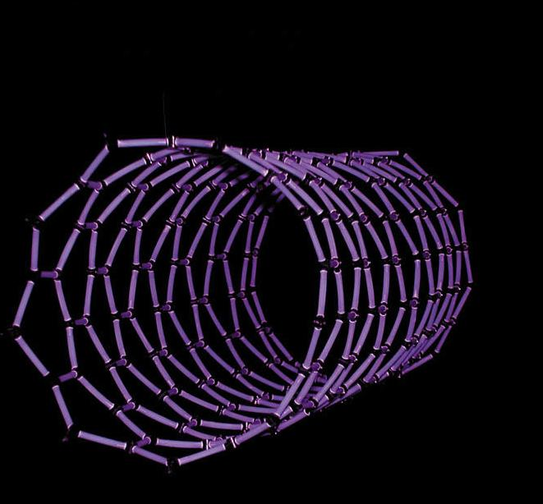
.
Carbon Nanotubes
Carbon nanotubes (CNTs) are allotropes of carbon. These cylindrical carbon molecules have interesting properties that make them potentially useful in many applications in nanotechnology, electronics, optics and other fields of materials science, as well as potential uses in architectural fields. They exhibit extraordinary strength and unique electrical properties, and are efficient conductors of heat. Their final usage, however, may be limited by their potential toxicity.
18PYB103J Module-V Lecture-7
Notes:
‹#›

Slide 3
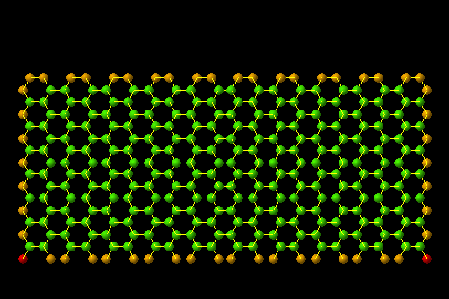
What Are Carbon Nanotubes
CNT can be described as a sheet of graphite rolled into a cylinder
Constructed from hexagonal rings of carbon
Can have one layer or multiple layers
Can have caps at the ends making them look like pills
‹#›
18PYB103J Module-V Lecture-7
Notes:
‹#›

Slide 4
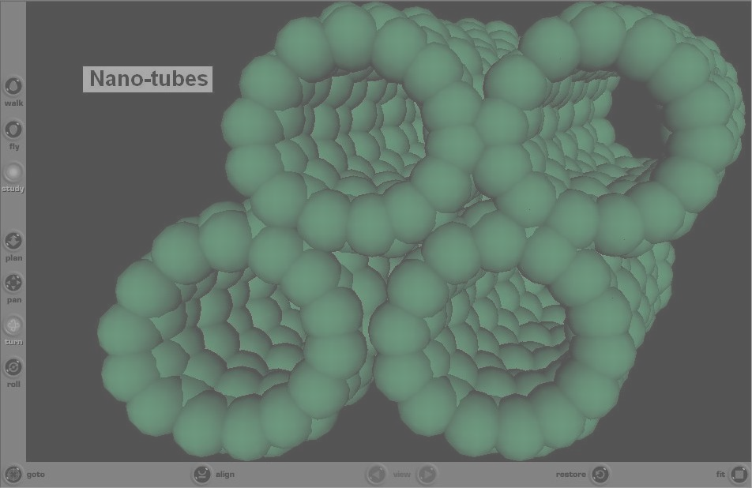

Discovery
They were discovered in 1991 by the Japanese electron microscopist Sumio Iijima who was studying the material deposited on the cathode during the arc-evaporation synthesis of fullerenes. He found that the central core of the cathodic deposit contained a variety of closed graphitic structures including nanoparticles and nanotubes, of a type which had never previously been observed
18PYB103J Module-V Lecture-7

Slide 5
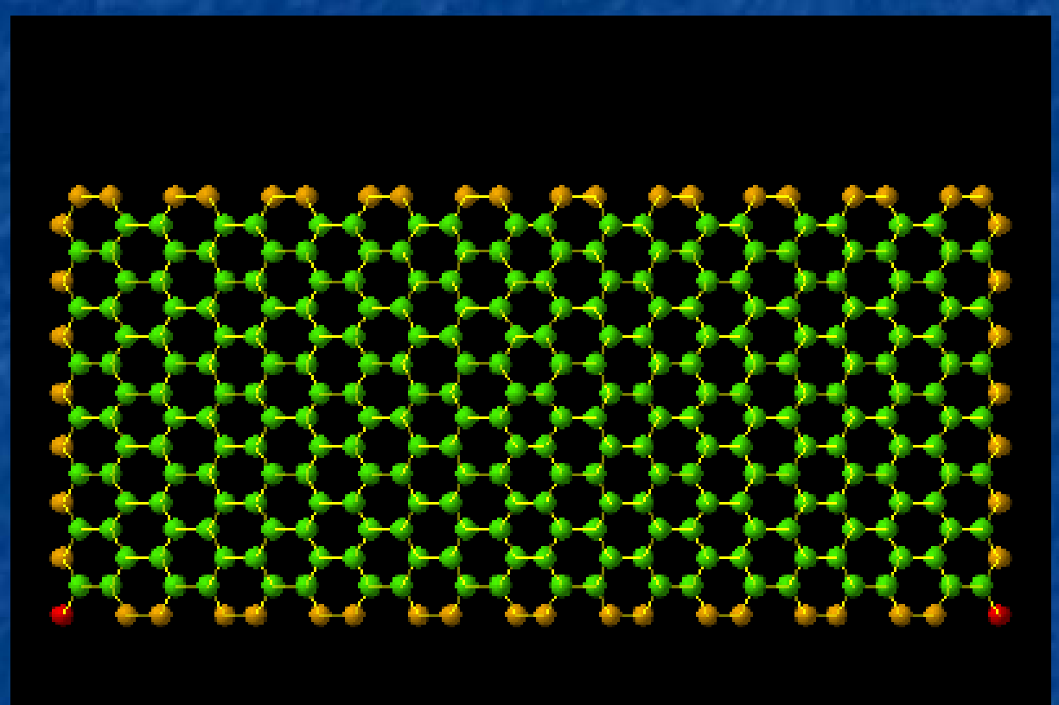
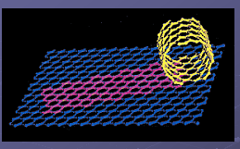
Carbon Nanotubes are built up using graphite sheet, which is the most stable form of crystalline carbon.
A carbon Nanotube is obtained by rolling up a plain graphite sheet into a tubular shape.
Roll up
Graphite Sheet
Carbon Nano Tube
‹#›
18PYB103J Module-V Lecture-7
Notes:
‹#›

Slide 6
Carbon Nanotube can be classified into Two type
Single wall carbon Nanotube (SWNT)
Multiwall Carbon Nanotube (MWNT)
Single-wall carbon Nanotubes (SWCNTs) can be considered to be formed by the rolling of a single layer of graphite into a seamless cylinder.
A Multiwall carbon Nanotube (MWCNT) can similarly be considered to be a coaxial assembly of cylinders of SWCNTs, one within another.
The separation between tubes is about equal to that between the layers in natural graphite. Hence, Nanotubes are one-dimensional objects.
‹#›
18PYB103J Module-V Lecture-7
Notes:
‹#›

Slide 7
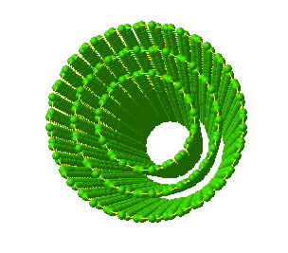
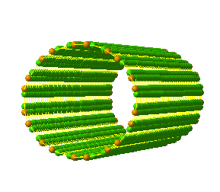
MWNT
Consist of 2 or more layers of carbon
Tend to form unordered clumps
SWNT
Consist of just one layer of carbon
Greater tendency to align into ordered bundles
Used to test theory of nanotube properties
Multi wall CNT
Single wall CNT
‹#›
18PYB103J Module-V Lecture-7
Notes:
‹#›

Slide 8

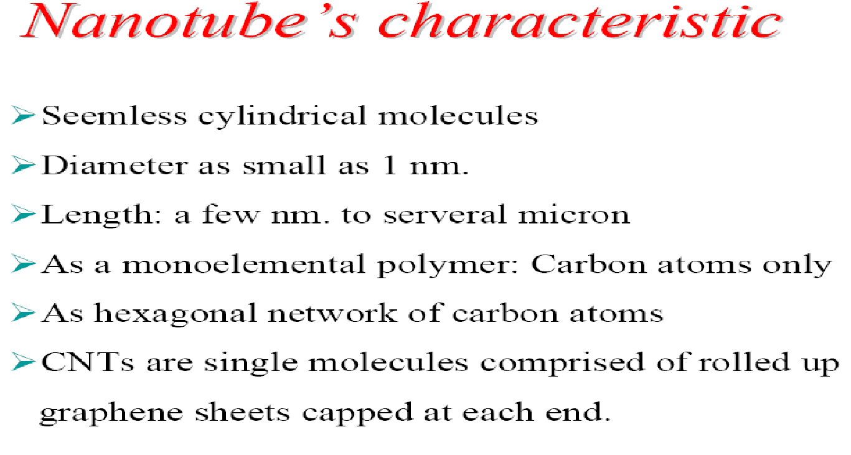
‹#›
18PYB103J Module-V Lecture-7
Notes:
‹#›

Slide 9
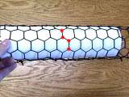
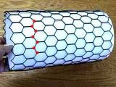
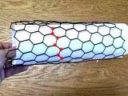
NANOTUBE GEOMETRY:
There are three unique geometries of carbon nanotubes. The three different
geometries are also referred to as flavors. The three flavors are armchair, zig-zag, and chiral [e.g. zig-zag (n, 0); armchair (n, n); and chiral (n, m)]. These flavors can be
classified by how the carbon sheet is wrapped into a tube
18PYB103J Module-V Lecture-7

Slide 10
If the Chiral vector passes through mid point of atomic bonding, it called "zig-zag line” Nanotube
If the Chiral vector passes through the atoms of six fold axis, it armchair line” Nanotube
If the Chiral vector line not along a mirror line then it is called chiral Nanotube
The Chiral angle and Chiral vector(C_{h}) of zigzag Nanotubes is 0º and (n,0)
The Chiral angle is 30º and Chiral vector (C_{h}) is (n,n) for armchair Nanotubes
The Chiral angle is 0 ≤ θ ≤ 30° The Chiral vector n≠m for Chiral Nanotube
‹#›
18PYB103J Module-V Lecture-7
Notes:
‹#›

Slide 11
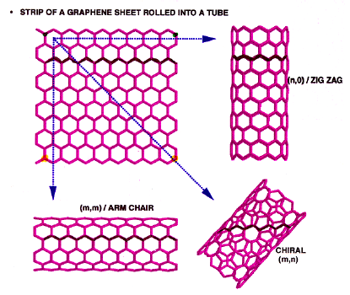
Graphene sheet
‹#›
18PYB103J Module-V Lecture-7
Notes:
‹#›

Slide 12
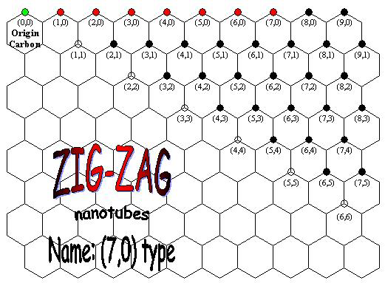
18PYB103J Module-V Lecture-7

Slide 13
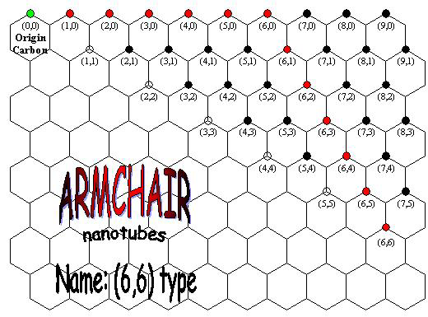
18PYB103J Module-V Lecture-7

Slide 14
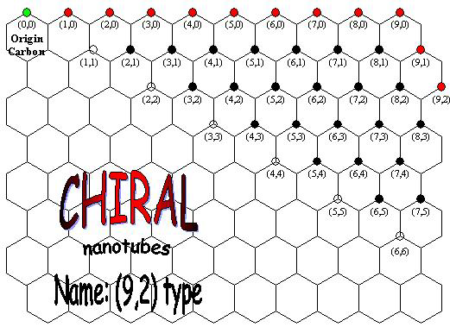
18PYB103J Module-V Lecture-7

Slide 15
CNT exhibits extraordinary mechanical properties:
The Young's modulus is over 1 Tera Pascal. It is stiff as diamond.
The estimated tensile strength is 200 GPa. These properties are ideal for reinforced composites, Nano electromechanical systems (NEMS)
The dimensions of CNT are variable (down to 0.4 nm in diameter)
Apart from remarkable tensile strength, CNT nanotubes exhibit varying electrical properties (depending on the way the graphite structure spirals around the tube, and other factors, such as doping), and can be superconducting, insulating, semiconducting or conducting (metallic)
‹#›
18PYB103J Module-V Lecture-7
Notes:
‹#›

Slide 16
CNT Nanotubes can be either electrically conductive or semi conductive, depending on their helicity ( shape), leading to nanoscale wires and electrical components.
These one-dimensional CNT fibers exhibit
Electrical conductivity as high as copper,
Thermal conductivity as high as diamond,
Strength 100 times greater than steel at one sixth the weight, and high strain to failure
Chemical reactivity.
The chemical reactivity of a CNT is very high as compared with a graphene sheet because of its curved surface.
A Nanotube with smaller diameter results in increased reactivity.
‹#›
18PYB103J Module-V Lecture-7
Notes:
‹#›

Slide 17
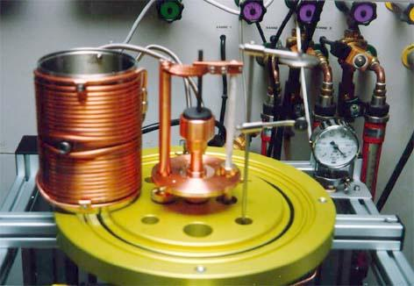
Synthesis of CNTs- Arc Discharge Method
A direct current creates a high temperature discharge between two electrodes (carbon is vapourized)
Atmosphere is composed of inert gas at a low pressure
Originally used to make C₆₀ fullerenes
Cobalt is a popular catalyst
Typical yield is 30-90%
http://lnnme.epfl.ch/page80437.html
18PYB103J Module-V Lecture-7
Notes:
1 min
‹#›

Slide 18
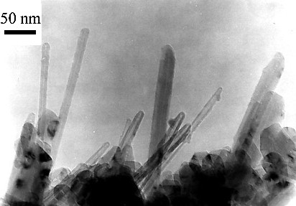
Arc Discharge Method
Advantages
Simple procedure
High quality product
Inexpensive
Disadvantages
Requires further purification
Tubes tend to be short with random sizes
18PYB103J Module-V Lecture-7
Notes:
30 s
‹#›

Slide 19
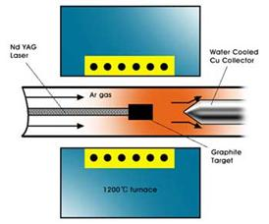
Laser Ablation Method
Discovered in 1995 at Rice University
Vaporizes graphite at 1200 ⁰C
Helium or argon gas
A hot vapor plume forms and expands and cools rapidly
Carbon molecules condense to form large clusters
Similar to arc discharge
Yield of up to 70%
18PYB103J Module-V Lecture-7
Notes:
1 min
‹#›

Slide 20
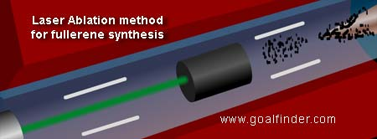
Types of Laser Ablation
Pulsed
Much higher light intensity (100 kW/cm²)
Continuous
Much lower light intensity (12 kW/cm²)
18PYB103J Module-V Lecture-7
Notes:
30 s
‹#›

Slide 21
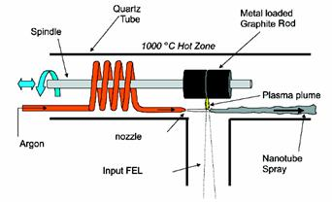
Ultra Fast-pulsed Laser Ablation
18PYB103J Module-V Lecture-7
Notes:
30 s
‹#›

Slide 22
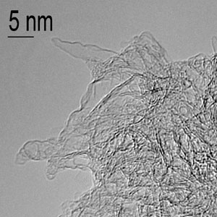
Laser Ablation
Advantages
Good diameter control
Few defects
Pure product
Disadvantages
Expensive because of lasers and high powered equipment
18PYB103J Module-V Lecture-7
Notes:
30 s
‹#›

Slide 23

Chemical Vapor Deposition
Carbon is in the gas phase
Energy source transfers energy to carbon molecule
Common Carbon Gases
Methane
Carbon monoxide
Acetylene
18PYB103J Module-V Lecture-7
Notes:
30 s
‹#›

Slide 24
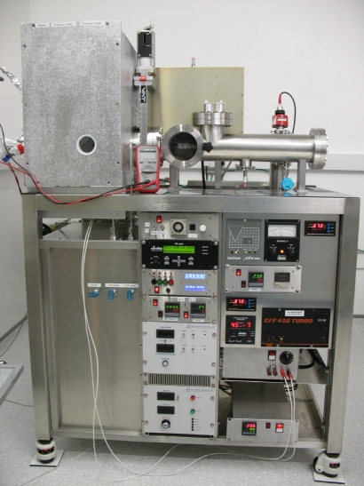
18PYB103J Module-V Lecture-7

Slide 25
Applications of carbon Nanotubes
‹#›
18PYB103J Module-V Lecture-7
Notes:
‹#›

Slide 26
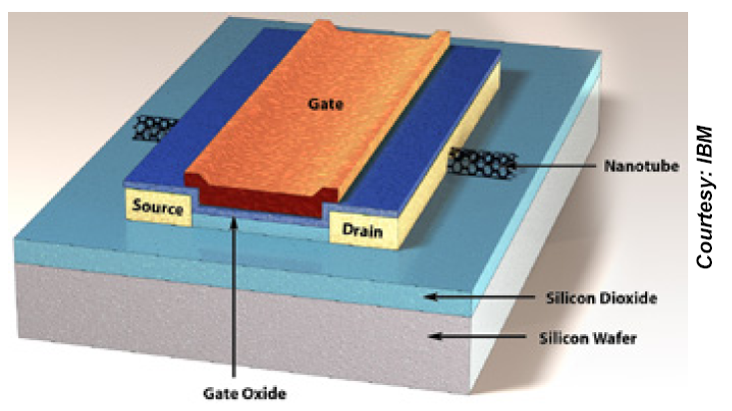
Carbon Nanotube can be used as a conducting channel in Field emission Transistor
CNT conducting channel result the device with low power consumption
CNT conducting tube
‹#›
18PYB103J Module-V Lecture-7

Slide 27
Nanoprobes and sensors
Because of their flexibility, nanotubes can also be used in scanning probe instruments.
Since MWNT tips are conducting, they can be used in STM and AFM instruments.
Advantages are the improved resolution in comparison with conventional Si or metal tips and the tips do not suffer from crashes with the surfaces because of their high elasticity.
However, Nanotube vibration, due to their large length, will remain an important issue until shorter nanotubes can be grown controllably.
Nanotube tips can be modified chemically by attachment of functional groups.
‹#›
18PYB103J Module-V Lecture-7

Slide 28
Electronic Devices
Nanotube TV’s
Nano-wiring
High Strength Composites
100 times as strong as steel and 1/6 the weight
Conductive Composites
Medical Applications
Encase drug into nanotube capsule for more predictable time release
‹#›
18PYB103J Module-V Lecture-7

Slide 29
Composite materials
Because of the stiffness of carbon nanotubes, they are ideal candidates for structural applications.
For example, they may be used as reinforcements in high strength, low weight, and high performance composites.
Theoretically, SWNTs could have a Young’s Modulus of 1 TPa.
MWNTs are weaker because the individual cylinders slide with respect to each other.
Ropes of SWNTs are also less strong.
The individual tubes can pull out by shearing and at last the whole rope will break.
‹#›
18PYB103J Module-V Lecture-7

Slide 30
Templates
Because of the small channels, strong capillary forces exist in nanotubes.
These forces are strong enough to hold gases and fluids in nanotubes.
In this way, it may be possible to fill the cavities of the nanotubes to create nanowires.
‹#›
18PYB103J Module-V Lecture-7

